Slide 1
SVR
Support Vector Regression

Slide 2
How it works
SVM – used for classification
Finds a hyperplane that separates the two classes
SVR - aims to find a hyperplane that passes through as many data points as possible within a certain distance – margin
Can handle non-linear relationships – using Kernel function
Kernels – functions that define the type of decision boundary used to model the relationship between input variables and target variable

Slide 3
Kernels
Linear Kernels – simple dot product between two input vectors
linear
Non-Linear Kernels – more complex function that can capture more intricate patters
Polynomial – accept different degrees of polynomials
RBF (Radial Basis Function) – popular choice – flexible in capturing non-linear relationship – introduces the ‘gamma’ hyperparameter
Sigmoid – represent decision boundaries similar to a sigmoid function

Slide 4
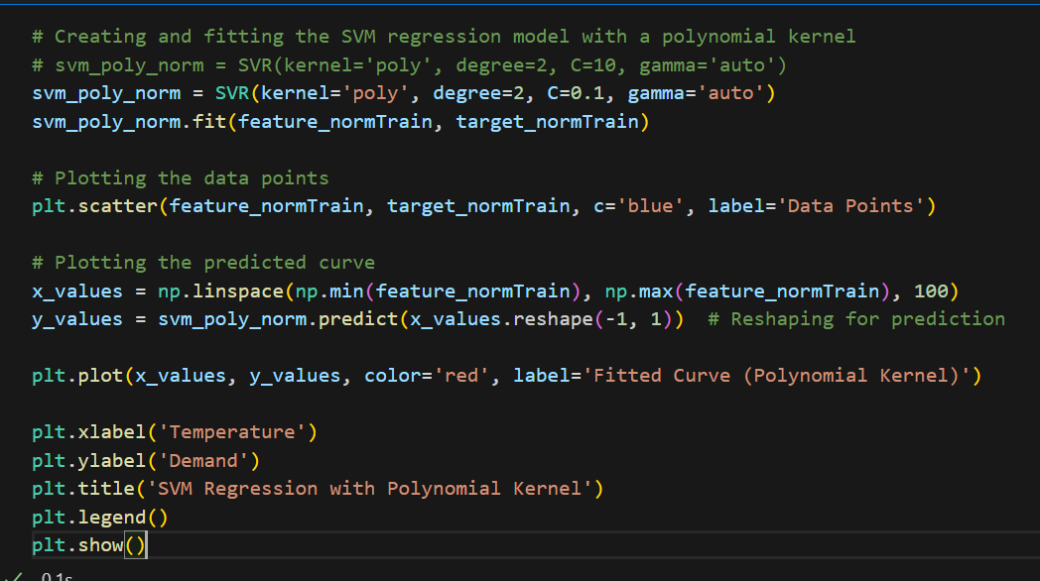
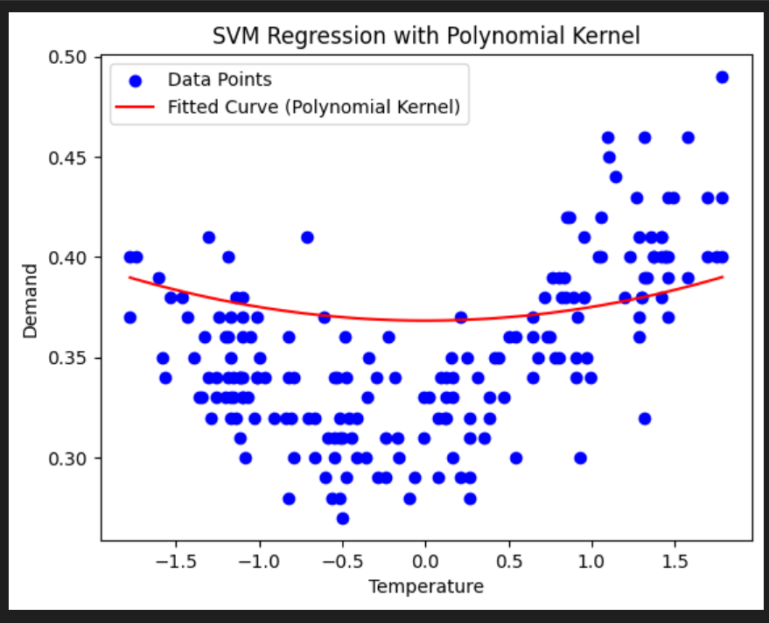
Visualising the hyperplane

Slide 5
Kernels & Hyperparameters
C’ – trade-off between achieving a low training error and keeping the model’s decision boundary smooth
Larger values – penalises more for misclassified points – higher training accuracy – risk of overfitting
Smaller values of C – model will be more lenient in allowing larger error, higher training error but more generalised model
Gamma – influence of support vectors on the hyperplane
Smaller gamma – larger influence for each support vector – model might generalize better
Larger gamma – shrinks the range of influence of support vectors (overfitting)
Epsilon - It specifies the epsilon-tube within which no penalty is associated in the training loss function with points predicted within a distance epsilon from the actual value

Slide 6
Note from SK-learn
Model produced by SVR depends only on a subset of the training data
Cost function ignores samples whose prediction is close to their target
SVM Algorithms are not scale invariant
Highly recommended to scale data
Scale each attribute on input vector and standardize
Same scaling must be applied to test vector to obtain good results
Proper choice of C & gamma is critical – advised to use GridSearchCV
https://scikit-learn.org/stable/modules/svm.html

Slide 7
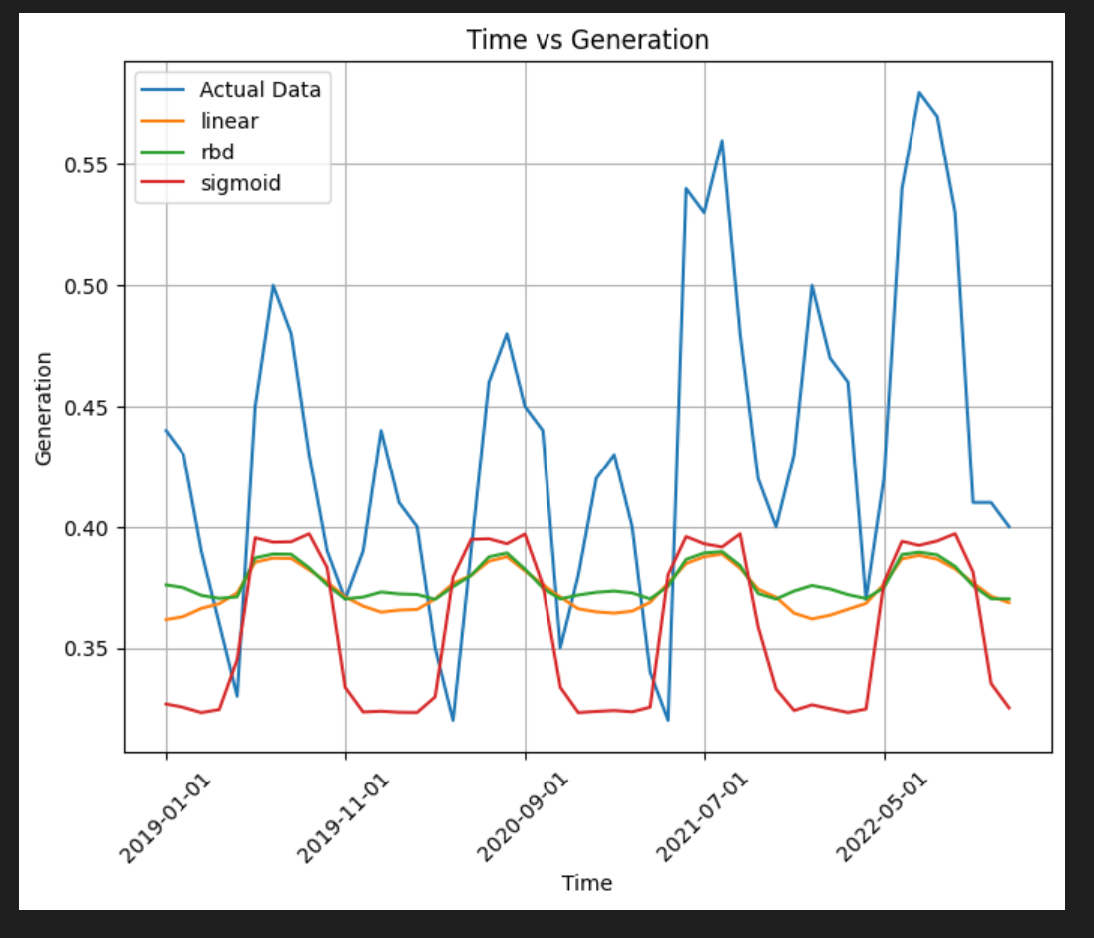
Selecting the hyperparameters
After testing various kernels on normalised data, results were still not satisfactory
Issue lies with the hyperparameters chosen
Use range() and itertools.product() to explore a grid of hyperparameters and run the model through different combinations

Slide 8
GridSearchCV
Cross Validation – technique used to assess how well a model generalizes to an independent dataset
Instead of using the whole training dataset as one, cross validation divides the dataset into k subsets and then performs training and validation k times – each time using a different subset as the validation set and remaining subsets as training sets.
Performance metrics – accuracy/mse etc are averaged to provide an overall performance estimate of the model
Choosing number of folds (subsets) depends on dataset, computational resources

Slide 9
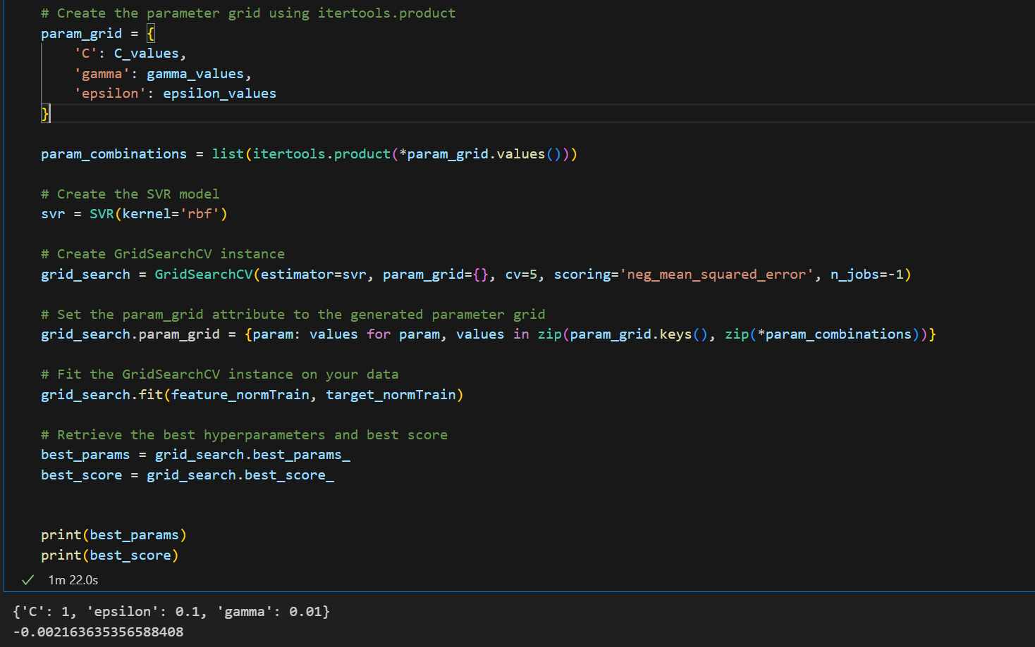

Slide 10
Re-testing using the suggested hyperparameters
No notable improvements resulted after this exercise
Normalisation and predictions were up till now done manually
Using the ‘pipeline’ method to verify the work
Very similar results obtained
Note that GridSearchCV is to be used on different kernels to get the best output

Slide 11
SK-Learn - NuSVR
SK-Learn provides the NuSVR algorithm
Uses parameter ‘nu’ to control the number of support vectors
Nu replaces the parameter epsilon
Possible Kernels – rbf, poly and sigmoid
‘Nu’ is tuneable
https://scikit-learn.org/stable/modules/generated/sklearn.svm.NuSVR.html#sklearn.svm.NuSVR

Slide 12
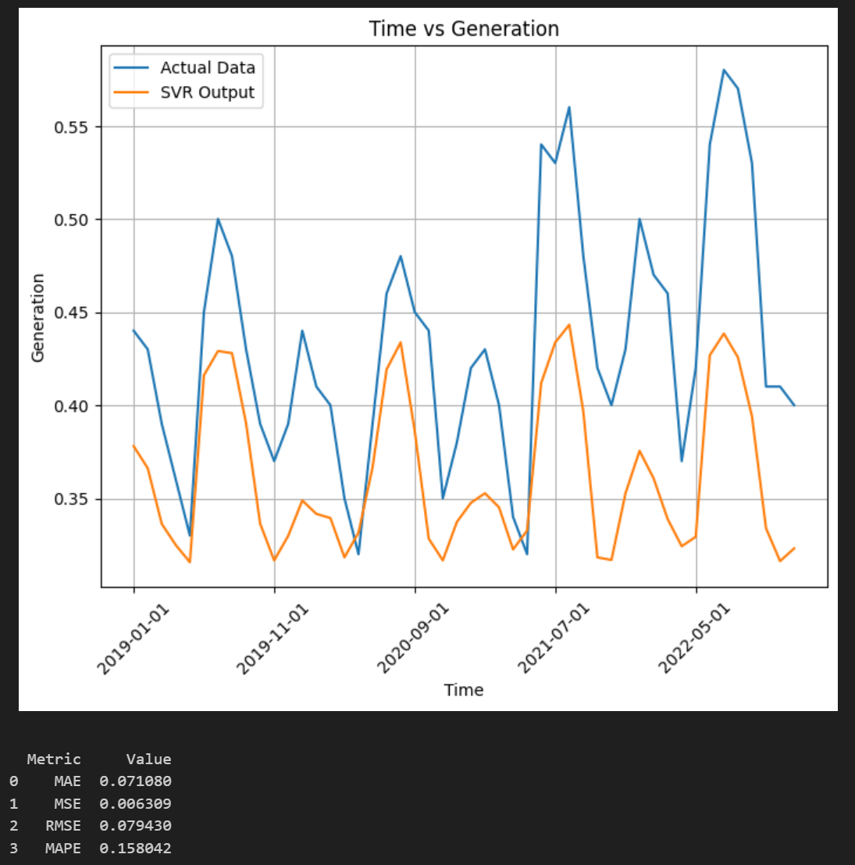

Slide 13
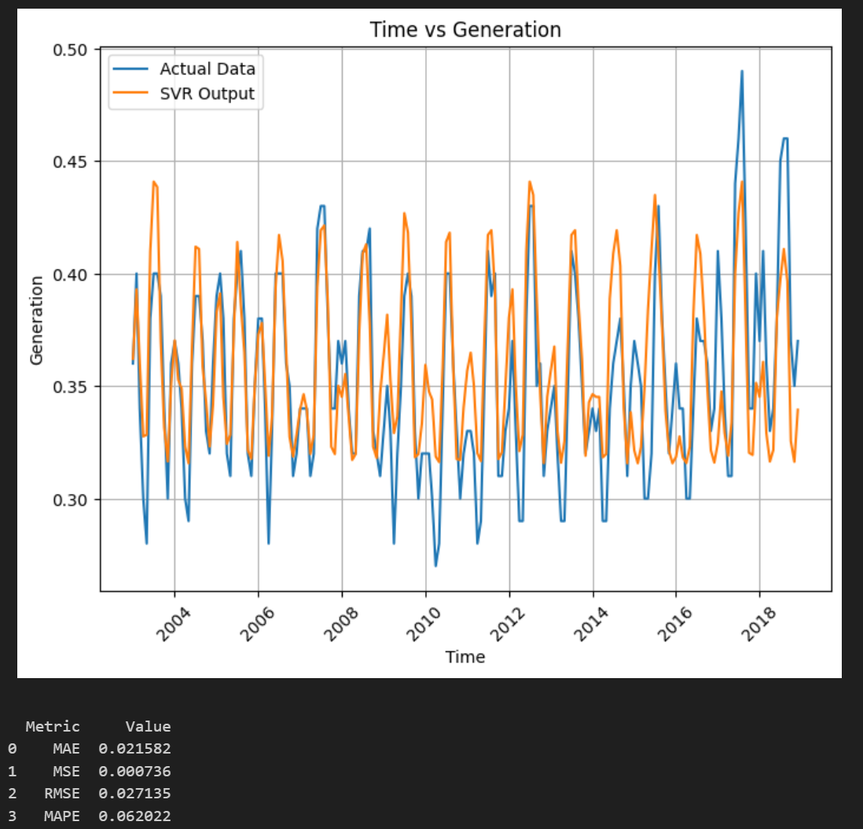
Visualising model on Training Data
Model fed training data to check output
6.2% MAPE

Slide 14
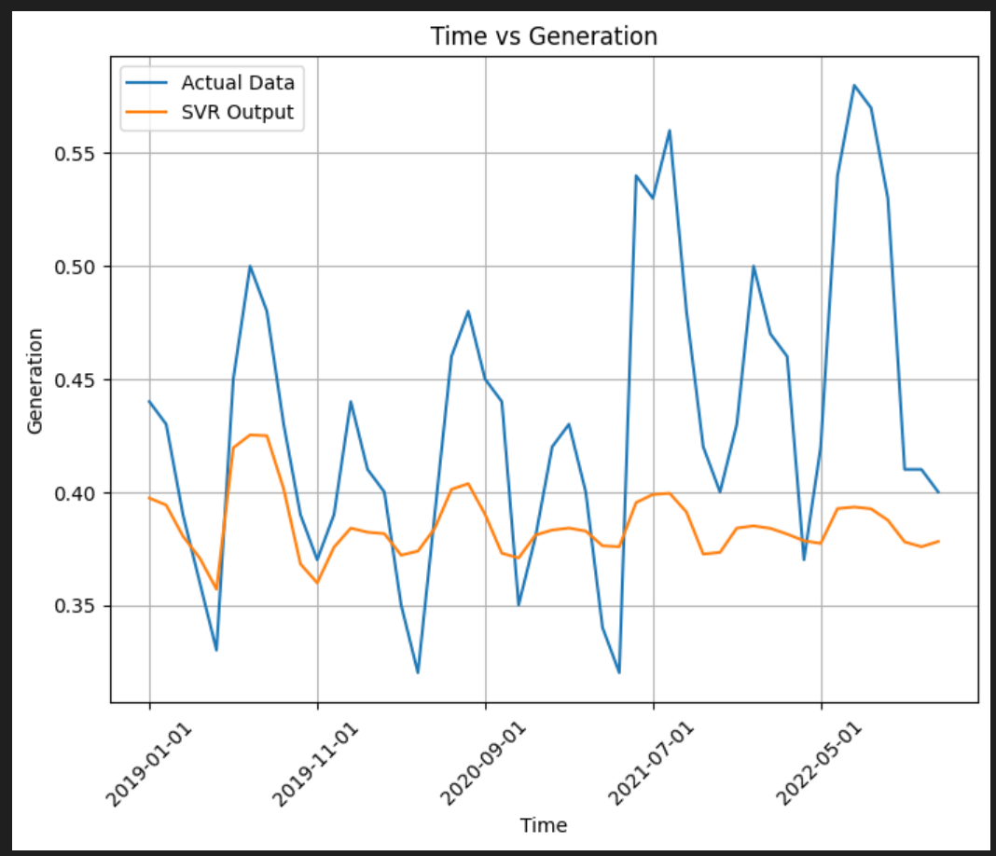
Dependency on Hyperparameters
Test re-run on a slightly different model – a new feature added
Using same hyperparameters
SVR is highly dependent on the selection of Hyperparameters

